Slide 1

Tech Gadget Usage and Mental Wellbeing
Aaron Tan
Mini-Project 2
#2025-07-08-ds-pt-wa-sg

Slide 2
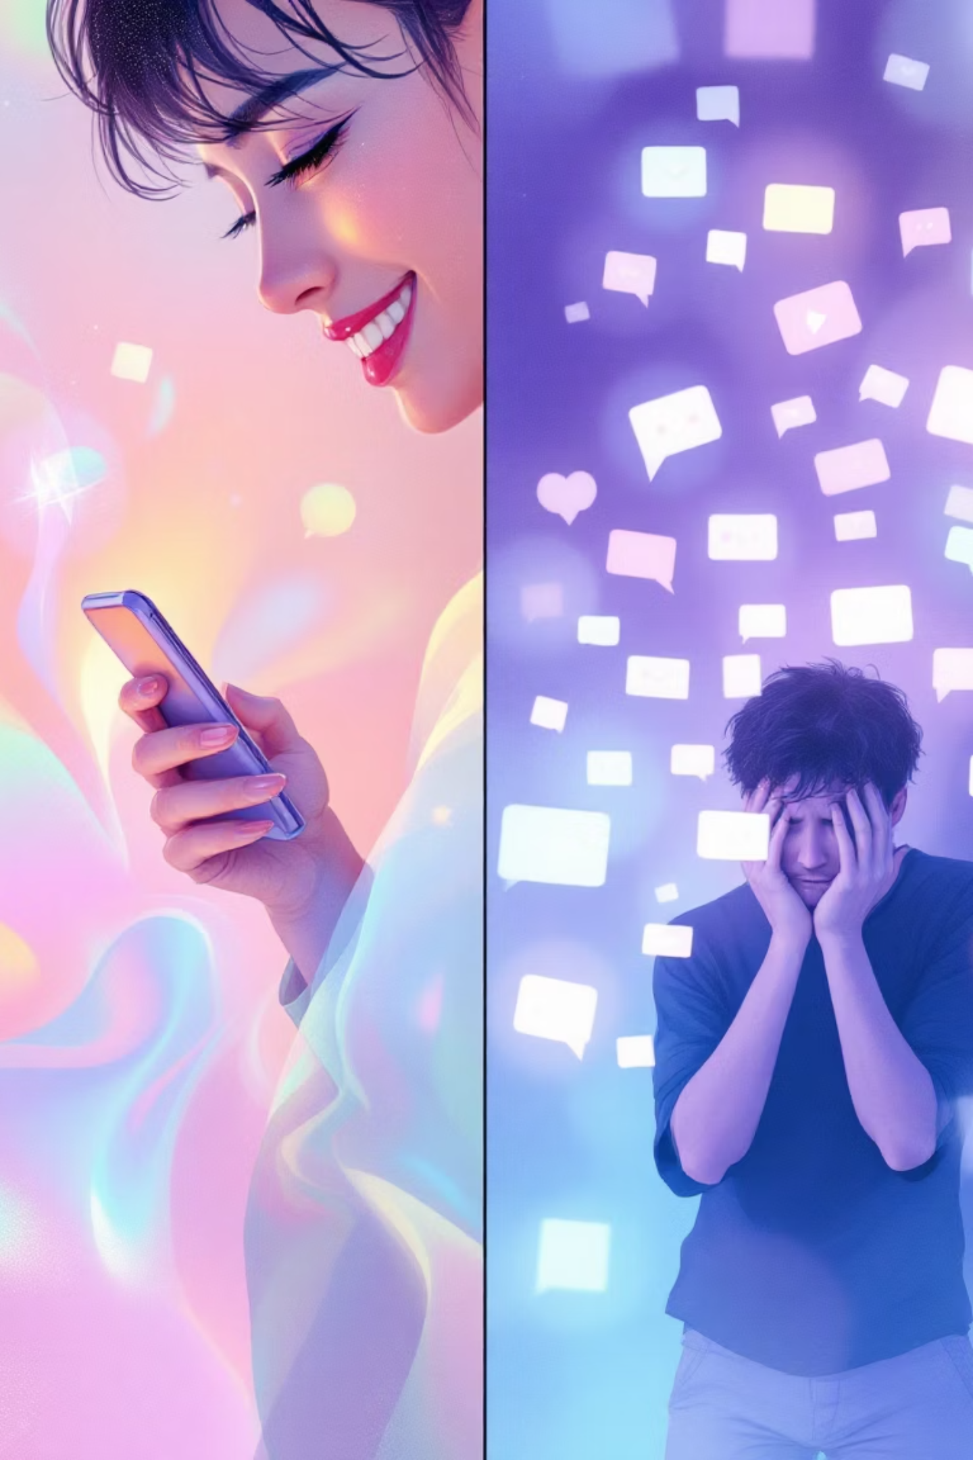
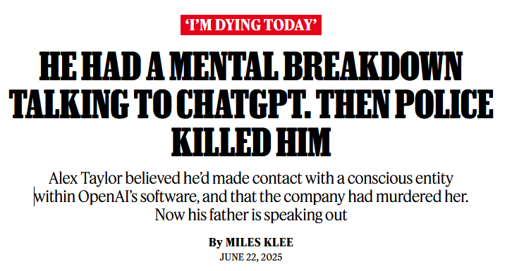
Article
Tech Gadget Use and the Rising Mental Health Crisis
Statistics:
80% of people with poor mental health feel dependent on technology.
Heavy screen use (6 hrs/day) is linked to 2-3X higher rates of depression and anxiety.
Asia has the highest impact due to long screen-time hours, high academic and work pressure.

Slide 3
Agenda
Intro
Audience
EDA
ML Models
Recommendations

Slide 4
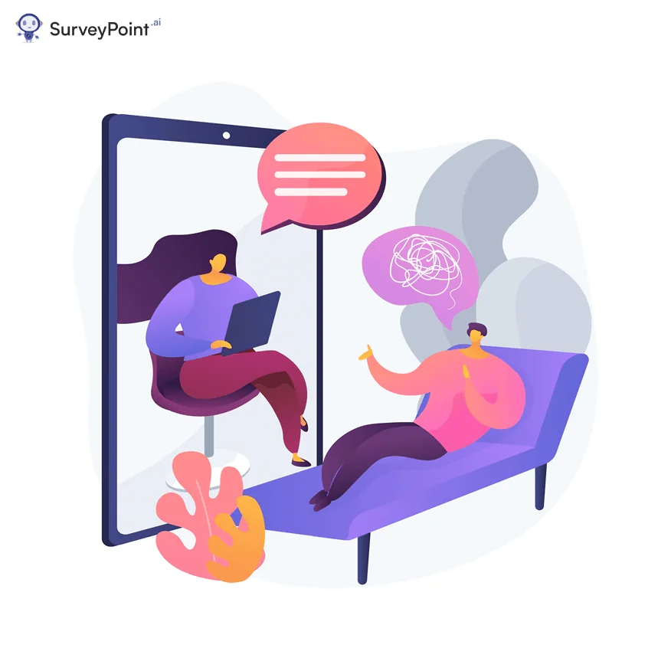
Introduction
Role Play Scenario
Picture this:
You have 24hrs in day:
Which are the following being bad for mental health:
A. Staying up late for 10 hours (9 PM – 7 AM) endlessly scrolling on your phone 📱
B. Working 20 hours straight to “stay productive” with no real breaks 💻
C. Comparing yourself on social media for 5 continuous hours 👀
D. Isolating yourself for an entire weekend, gaming non-stop and sleeping only 3–4 hours a night 😶‍🌫️
E. Checking messages and work notifications within 5 seconds of waking up - every single morning ☀️

Slide 5
Introduction
Main Point?
What key features or habits do you notice that contribute to poor mental health - and how can we recognize when they start to negatively affect us?
Quiz:
A. Staying up late for 10 hours (9 PM – 7 AM) endlessly scrolling on your phone 📱
B. Working 20 hours straight to “stay productive” with no real breaks 💻
C. Comparing yourself on social media for 5 continuous hours 👀
D. Isolating yourself for an entire weekend, gaming non-stop and sleeping only 3–4 hours a night 😶‍🌫️
E. Checking messages and work notifications within 5 seconds of waking up - every single morning ☀️
Are these everyday habits signs of high mental health risk, or
are they just low-risk routines we’ve normalised?

Slide 6
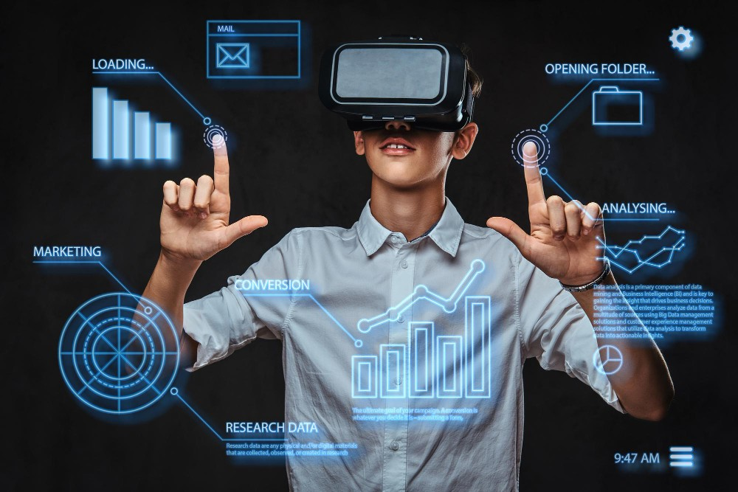
Audience
Stakeholder: Mental Health Professionals
Professional Examples: Psychologists, counsellors
How They’re Impacted: Increasing number of clients with gadget-related anxiety, burnout, and sleep problems.
Must adapt therapy methods to address digital stress, social comparison, and online addiction.
Need to understand digital behaviour patterns to provide relevant interventions.

Slide 7
Audience
Why this problem worth investigating?
📱 Digital overuse is rising — most youths spend 7–10 hours daily on screens, leading to stress, poor sleep, and burnout.
🧠 Mental health issues are increasing among Gen Z and young adults, closely linked to excessive gadget use.
🎓 Focus and productivity are declining in both education and workplaces due to constant digital distractions.
📊 Data-driven research enables real solutions — promoting healthy tech habits and early detection of digital stress.
🌍 Socially relevant — understanding these effects helps build a mentally healthier, more balanced digital generation.

Slide 8
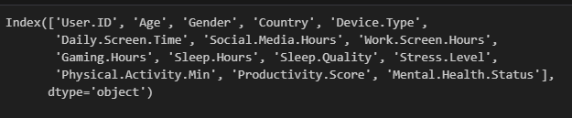
EDA
1,000 records | 15 features 🧠 Goal: Predict “Mental Health Status” using lifestyle and gadget-usage indicators (e.g., screen time, sleep, gaming, productivity).
The target variable: Mental Health Status, is a multiclass classification feature divided into three categories:
🟢Healthy: No known mental health issues
🟡Moderate: Some stress, anxiety, or occasional low mood
🔴Chronic: Ongoing or clinically significant mental health concerns

Slide 9
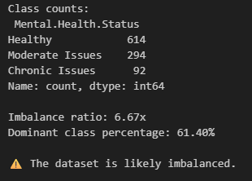
EDA
Dataset balanced?
The target variable: Mental Health Status, is a multiclass classification feature divided into three categories:
🟢Healthy: No known mental health issues
🟡Moderate: Some stress, anxiety, or occasional low mood
🔴Chronic: Ongoing or clinically significant mental health concerns

Slide 10
ML Models Agenda
Key metrics revelance – ML Model
Baseline Models
Separate Visualisation
Ensemble Models
Separate Visualisation
UI Application Showcase

Slide 11
Key Metrics Relevance – ML Model

Slide 12
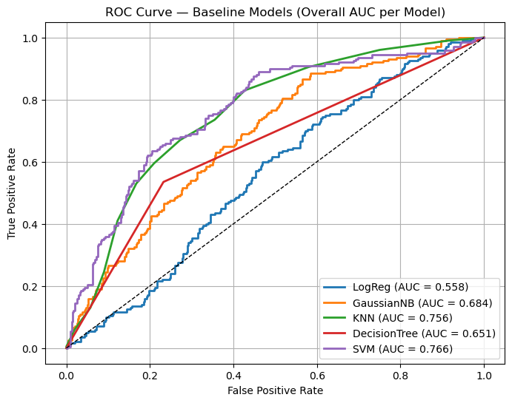
ML Models
Baseline Comparison Evaluation:
📈 Support Vector Machine (SVM) achieved the highest AUC score of 0.766, indicating strong ability to distinguish between different mental health status categories.
⚠️ Logistic Regression performed poorly with an AUC of 0.558, suggesting weak separation power and limited predictive reliability for this dataset.

Slide 13
ML Models
Baseline Separate Visualisation:
📈 Support Vector Machine (SVM) achieved the highest AUC score of 0.766, indicating strong ability to distinguish between different mental health status categories.
⚠️ Logistic Regression performed poorly with an AUC of 0.558, suggesting weak separation power and limited predictive reliability for this dataset.

Slide 14
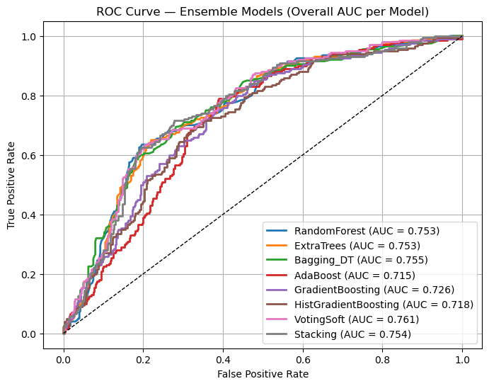
ML Models
Ensemble Comparison Visualisation:
📈 VotingSoft achieved the highest AUC score of 0.761, indicating strong ability to distinguish between different mental health status categories.
Models such as has similar AUC performance:
RandomForest
ExtraTrees
Bagging_DT
Stacking
Minor variance models:
AdaBoost (AUC: 0.715)
HistGradientBoosting (AUC: 0.718)

Slide 15
ML Models
Ensemble Comparison Evaluation:
📈 VotingSoft achieved the highest AUC score of 0.761, indicating strong ability to distinguish between different mental health status categories.

Slide 16
UI Application Showcase

Slide 17
Recommendations

Slide 18




The Dopamine Trap: How Tech Hijacks Our Brains
Notification Trigger
Dopamine Release
Craving Cycle
Each ping, buzz, or flash activates our brain's reward system, creating anticipation for potential rewards.
Likes, comments, and messages trigger dopamine bursts, the same neurotransmitter involved in addiction pathways.
Users spend 2.5 hours daily on social media, trapped in cycles of seeking validation and stimulation.

Slide 19
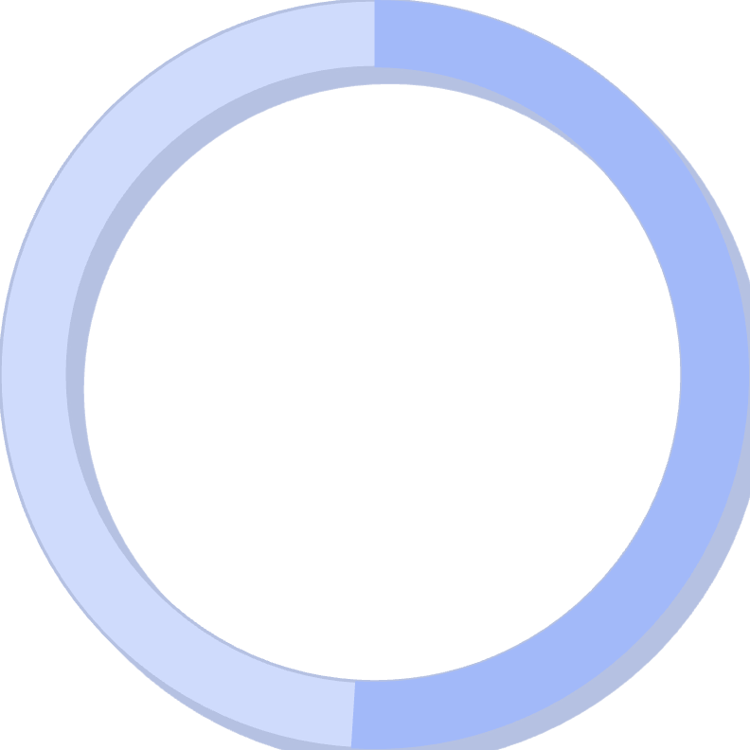
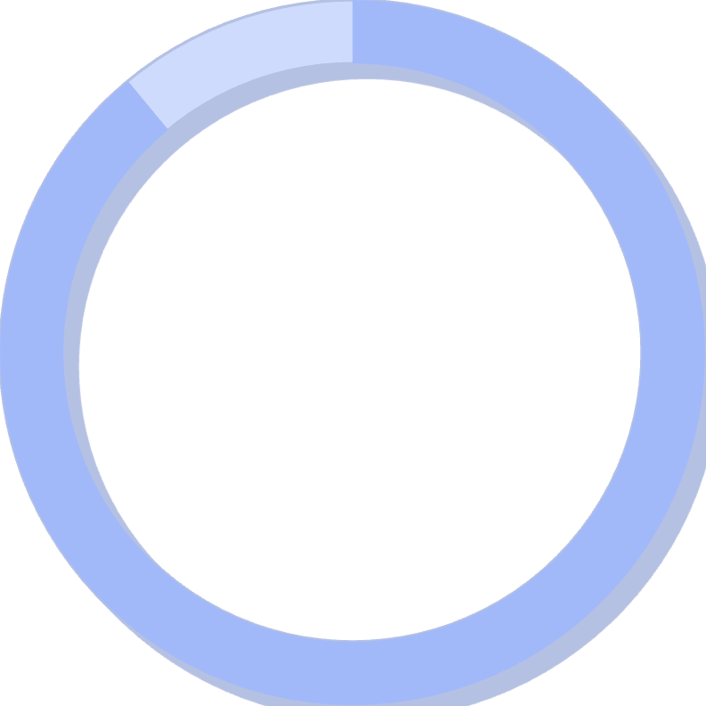
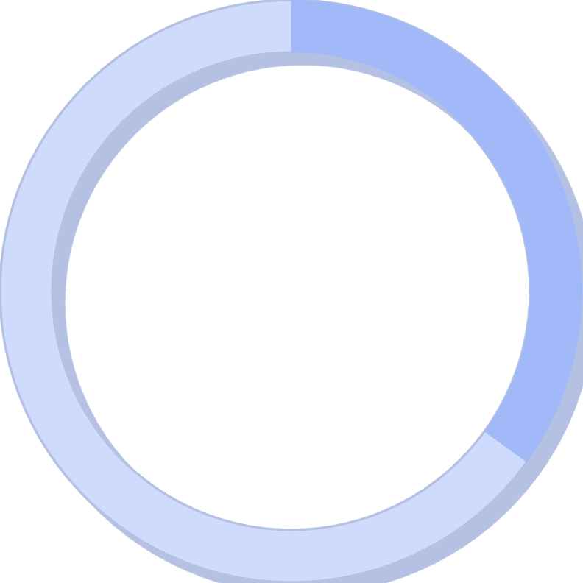
The Comparison Game: Social Media's Impact on Self-Esteem
51%
89%
35%
Teen Inadequacy
Filtered Reality
Body Image Issues
Report feeling inadequate due to social media comparisons with peers and influencers.
Of social media posts use filters or editing, creating unrealistic beauty standards.
Increase in body dysmorphia cases linked to social media usage among young adults.
"The curated perfection of online profiles fuels unrealistic expectations, creating a dangerous gap between digital fantasy and authentic reality."

Slide 20
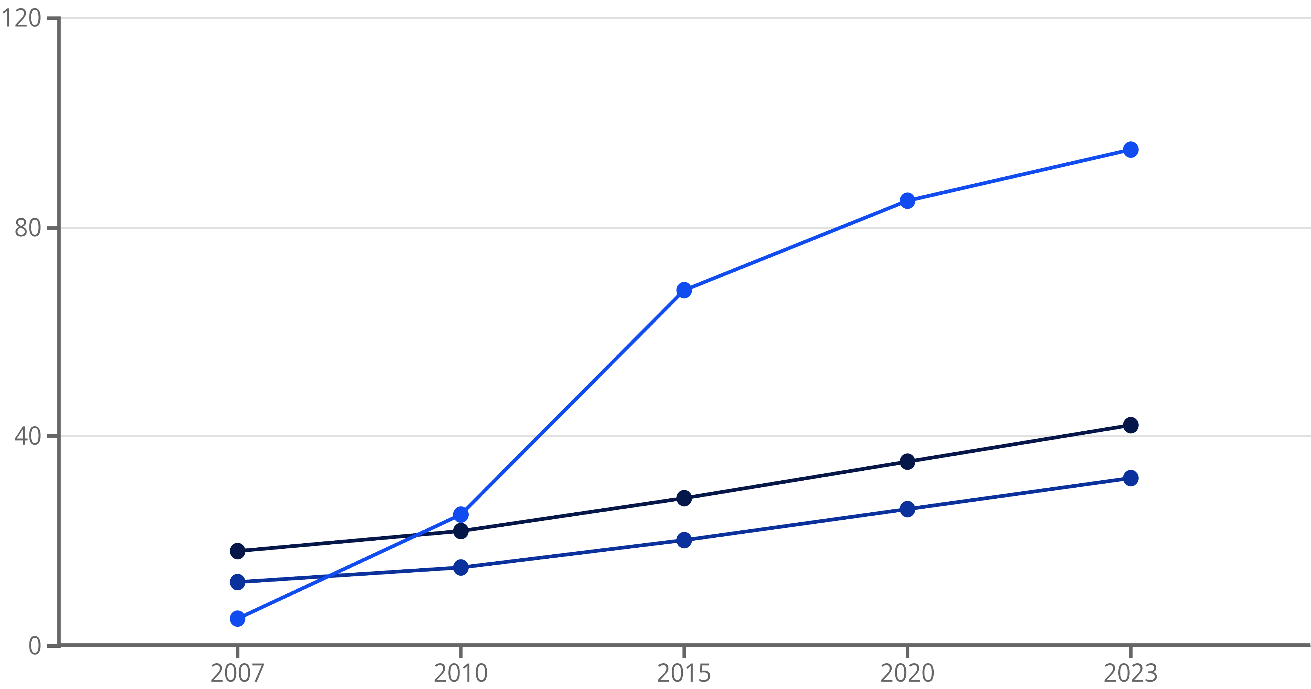
The Mental Health Crisis Timeline
Anxiety Rates (%)
Depression Rates (%)
Smartphone Adoption (%)
The correlation between rising smartphone adoption and increasing mental health challenges among young people raises critical questions about causation versus correlation in our digital age.

Slide 21

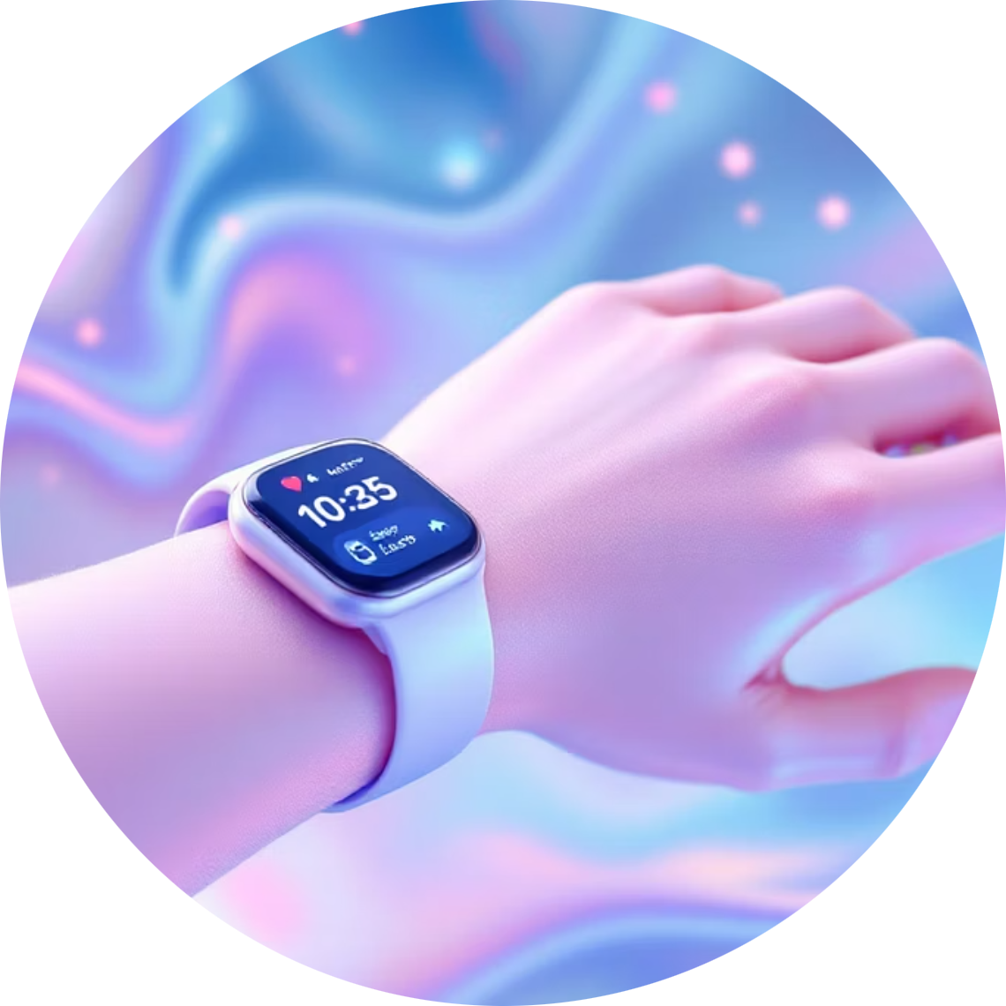


Tech as a Tool for Wellbeing: The Silver Linings
Mindfulness Apps
Wearable Wellness
Digital Therapy
Platforms like Headspace and Calm provide guided meditations, sleep stories, and breathing exercises accessible anytime, anywhere.
Smart devices track sleep patterns, heart rate variability, and stress levels, offering personalized insights for better health management.
Teletherapy platforms break down barriers to mental health care, providing professional support to those who might otherwise go without.
When used intentionally, technology becomes a powerful ally in our mental health journey, offering tools and resources that were unimaginable just decades ago.

Slide 22
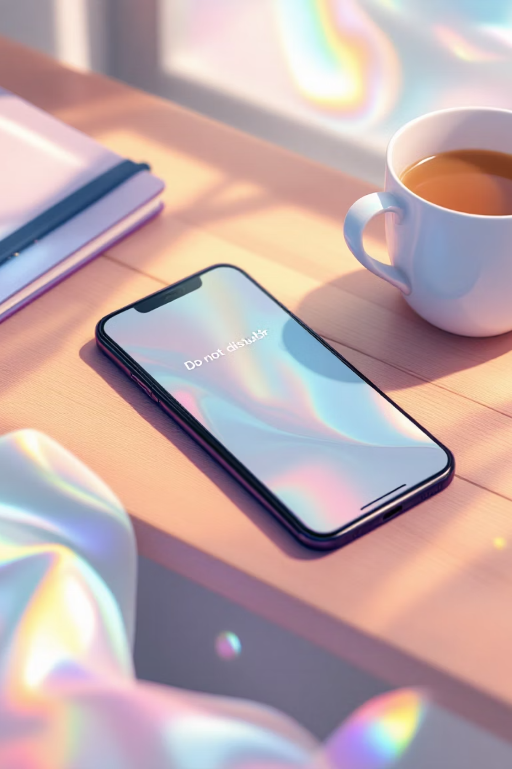
Digital Detox: Reclaiming Your Time and Mind
01
Set Sacred Boundaries
Create tech-free zones and times: no devices during meals, one hour before bed, or first thing in the morning.
02
Curate Your Digital Environment
Unfollow accounts that trigger negative emotions. Follow creators who inspire, educate, and uplift your mental state.
03
Practice Mindful Engagement
Before picking up your device, pause and ask: "What am I hoping to accomplish?" Avoid mindless scrolling.
04
Embrace Analog Alternatives
Rediscover physical books, handwritten journals, face-to-face conversations, and outdoor activities without digital distractions.

Slide 23




The Future is Now: Tech's Role in Mental Wellness
Technology is Neutral
Embrace Supportive Tools
Our devices aren't inherently good or bad—their impact depends entirely on how mindfully and intentionally we choose to use them.
Actively seek out and utilize technologies that genuinely support your mental health, productivity, and overall wellbeing.
Take Control
You are the architect of your digital life. Set boundaries, make conscious choices, and prioritize your psychological wellness above all else.
As we navigate this digital age, remember that the power to shape technology's impact on our mental health lies firmly in our hands. Choose wisely, live intentionally, and let technology serve your highest good.

